Slide 1

Computer Networks: A Systems Approach, 6e
Larry L. Peterson and Bruce S. Davie
Chapter 1
Foundation
This work is licensed under a Creative Commons Attribution 4.0 License.

Slide 2
Problems
How to build a scalable network that will support different applications?
What is a computer network?
How is a computer network different from other types of networks?
What is a computer network architecture?

Slide 3
Chapter Outline
Applications
Requirements
Network Architecture
Implementing Network Software
Performance

Slide 4
Chapter Goal
Exploring the requirements that different applications and different communities place on the computer network
Introducing the idea of network architecture
Introducing some key elements in implementing Network Software
Define key metrics that will be used to evaluate the performance of computer network

Slide 5
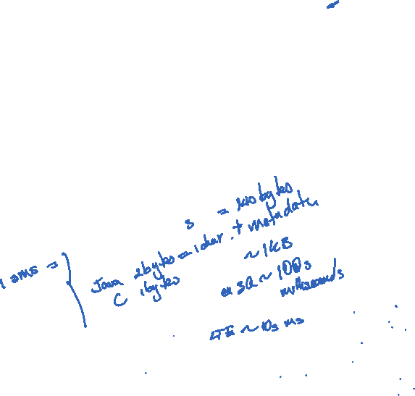
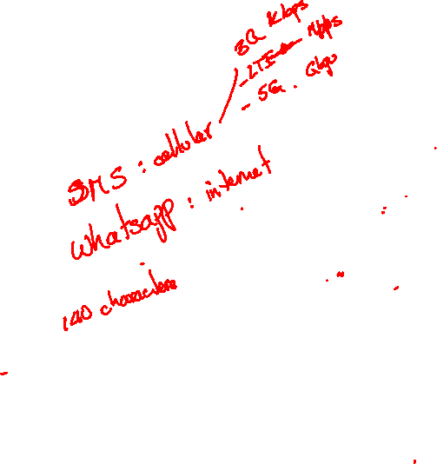
Applications
Most people know about the Internet (a computer network) through applications
World Wide Web
Email
Online Social Network
Streaming Audio Video
File Sharing
Instant Messaging
…

Slide 6
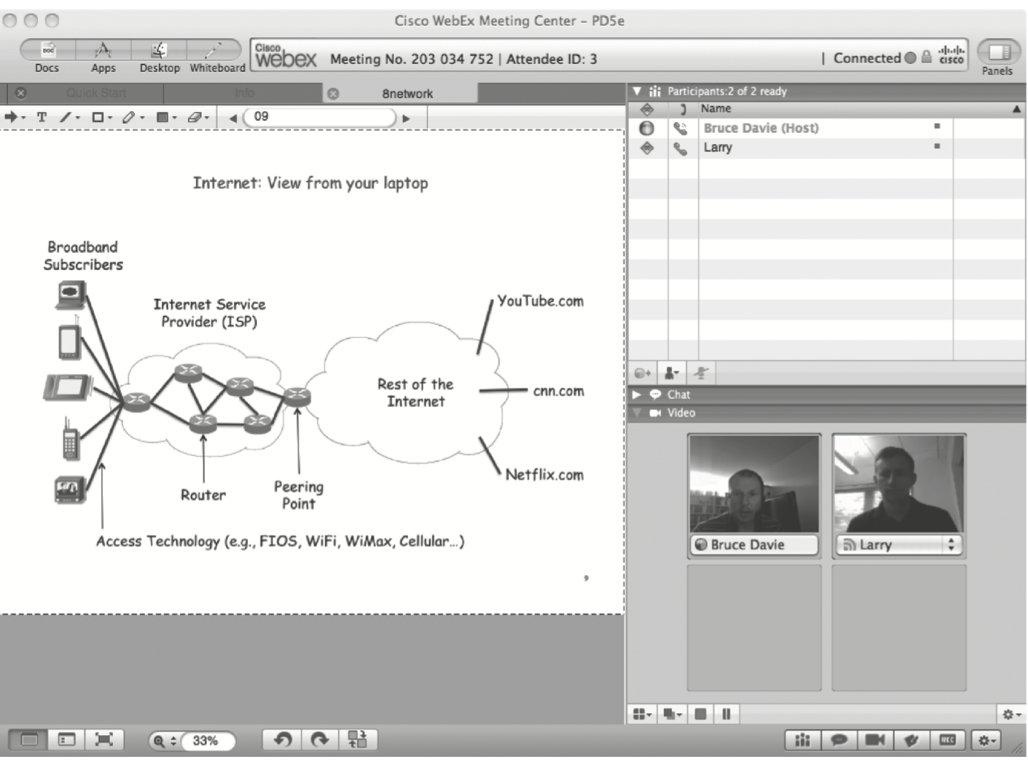

Example of an application
A multimedia application including video-conferencing

Slide 7

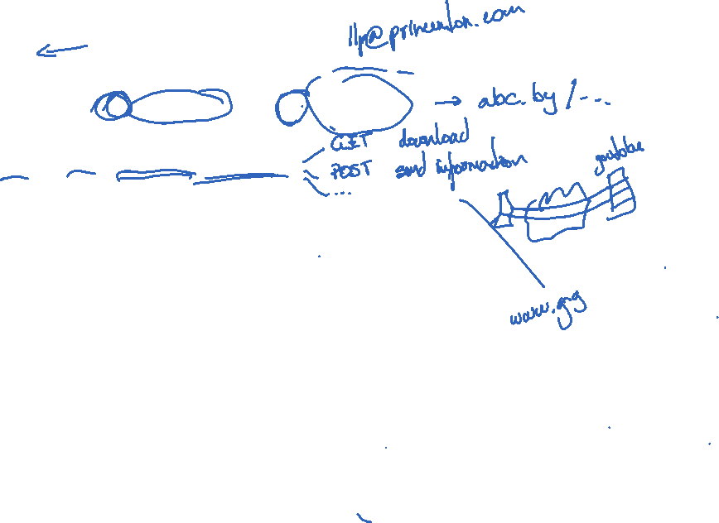
Application Protocol
URL
Uniform resource locater
http://www.cs.princeton.edu/~llp/index.html
HTTP
Hyper Text Transfer Protocol
TCP
Transmission Control Protocol
17 messages for one URL request
6 to find the IP (Internet Protocol) address
3 for connection establishment of TCP
4 for HTTP request and acknowledgement
Request: I got your request and I will send the data
Reply: Here is the data you requested; I got the data
4 messages for tearing down TCP connection

Slide 8
Requirements
Application Programmer
List the services that his application needs: delay bounded delivery of data
Network Designer
Design a cost-effective network with sharable resources
Network Provider
List the characteristics of a system that is easy to manage

Slide 9
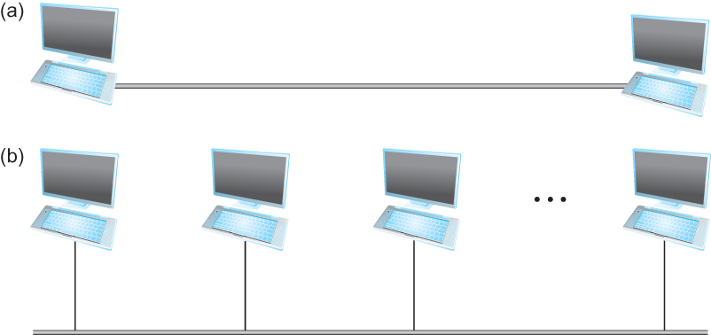


Connectivity
Need to understand the following terminologies
Scale
Link
Nodes
Point-to-point
Multiple access
Switched Network
Circuit Switched
Packet Switched
Packet, message
Store-and-forward
Point-to-point
Multiple access

Slide 10
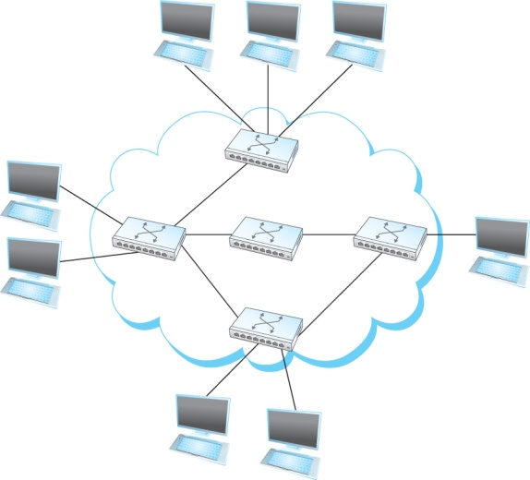
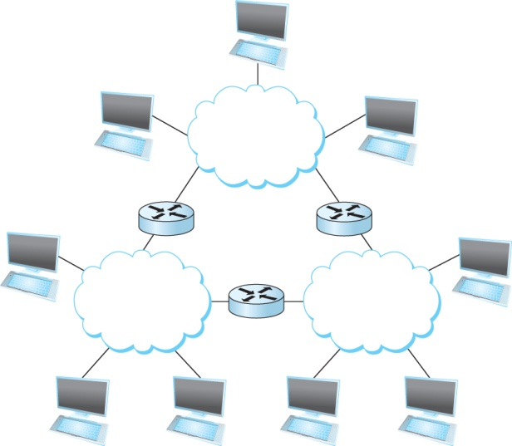
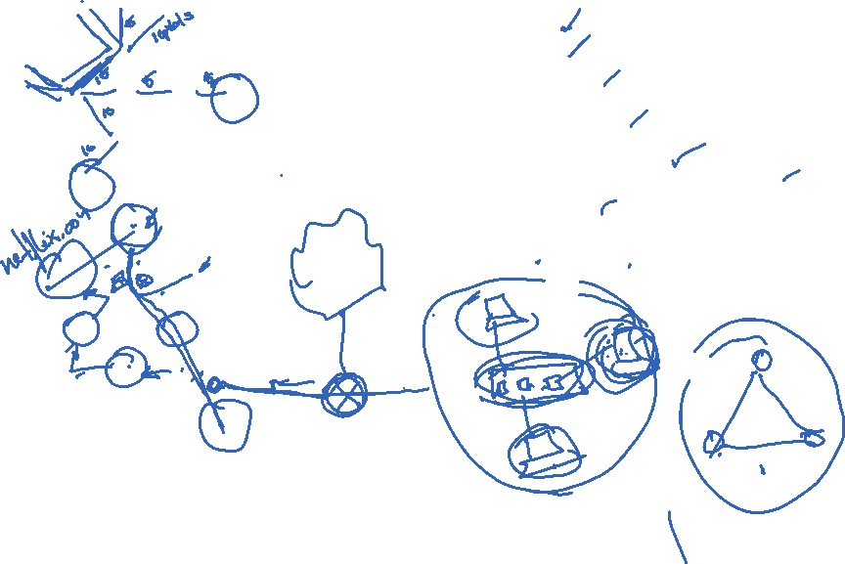

Connectivity
Terminologies (contd.)
Cloud
Hosts
Switches
internetwork
Router/gateway
Host-to-host connectivity
Address
Routing
Unicast/broadcast/multicast
(a)
(b)
A switched network
Interconnection of networks

Slide 11
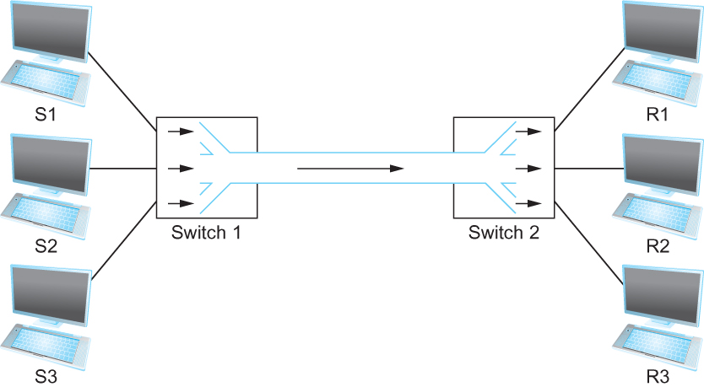
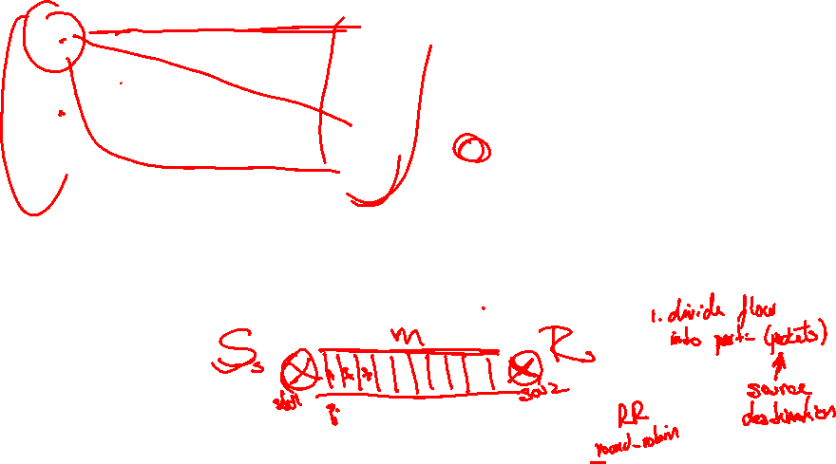
Cost-Effective Resource Sharing
Resource: links and nodes
How to share a link?
Multiplexing
De-multiplexing
Synchronous Time-division Multiplexing
Time slots/data transmitted in predetermined slots
Multiplexing multiple logical flows over a single physical link

Slide 12
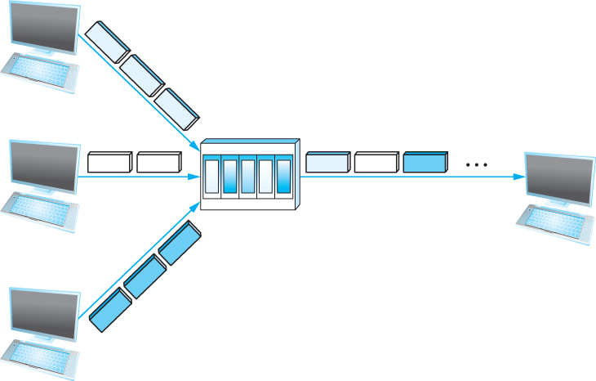
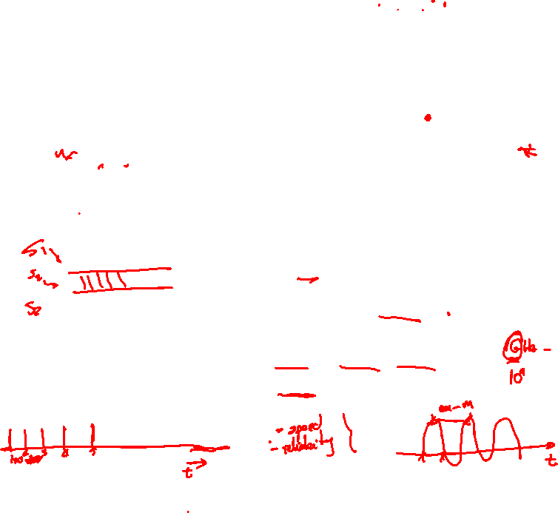
Cost-Effective Resource Sharing
FDM: Frequency Division Multiplexing
Statistical Multiplexing
Data is transmitted based on demand of each flow.
What is a flow?
Packets vs. Messages
FIFO, Round-Robin, Priorities (Quality-of-Service (QoS))
Congested?
LAN, MAN, WAN
SAN (System Area Networks
A switch multiplexing packets from multiple sources onto one shared link

Slide 13
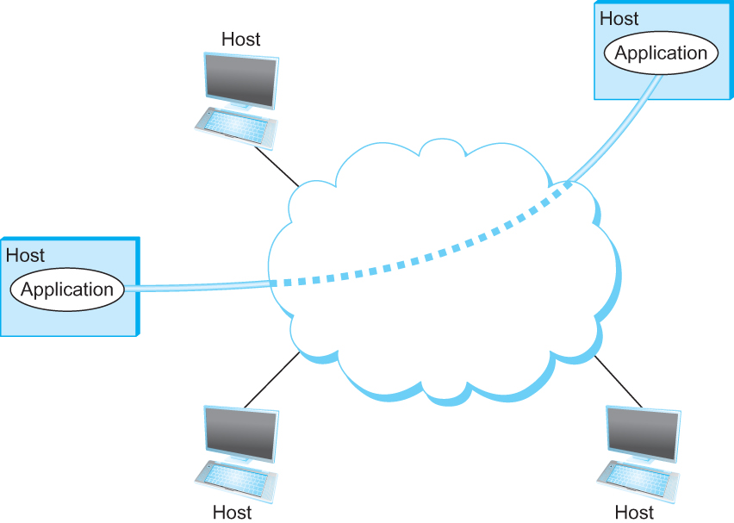

Support for Common Services
Logical Channels
Application-to-Application communication path or a pipe
Process communicating over an abstract channel

Slide 14
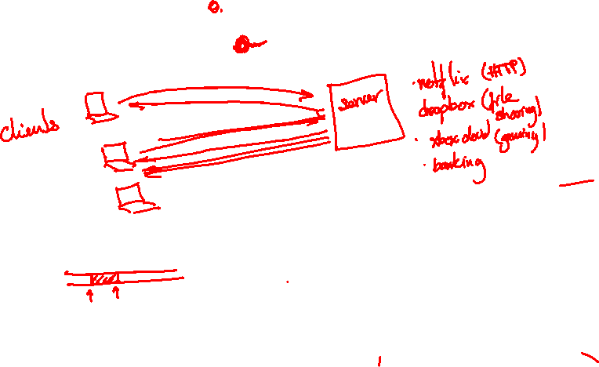
Common Communication Patterns
Client/Server
Two types of communication channel
Request/Reply Channels
Message Stream Channels

Slide 15
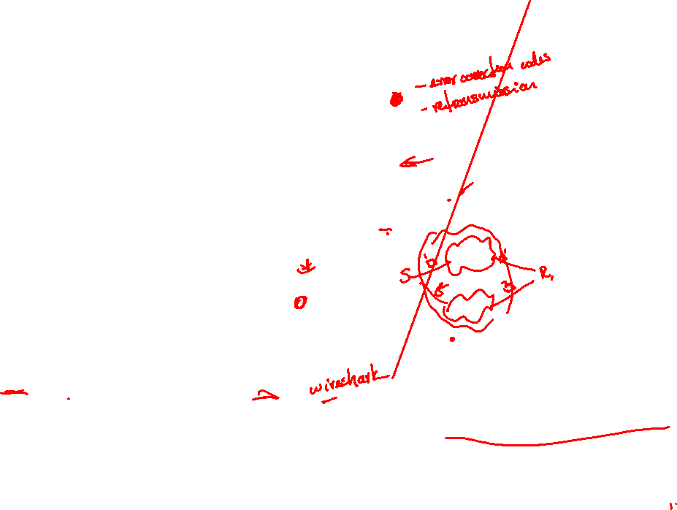
Reliability
Network should hide the errors
Bits are lost
Bit errors (1 to a 0, and vice versa)
Burst errors – several consecutive errors
Packets are lost (Congestion)
Links and Node failures
Messages are delayed
Messages are delivered out-of-order
Third parties eavesdrop

Slide 16
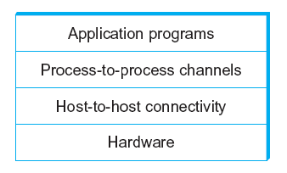

Network Architecture
Example of a layered network system

Slide 17
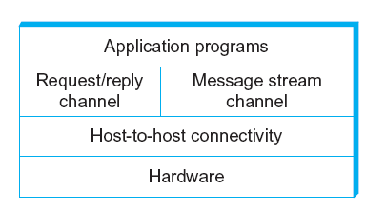
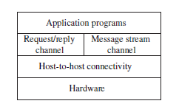

Network Architecture
Layered system with alternative abstractions available at a given layer

Slide 18
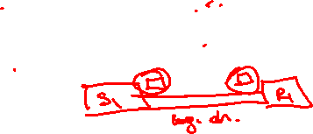
Protocols
Protocol defines the interfaces between the layers in the same system and with the layers of peer system
Building blocks of a network architecture
Each protocol object has two different interfaces
service interface: operations on this protocol
peer-to-peer interface: messages exchanged with peer
Term “protocol” is overloaded
specification of peer-to-peer interface
module that implements this interface

Slide 19
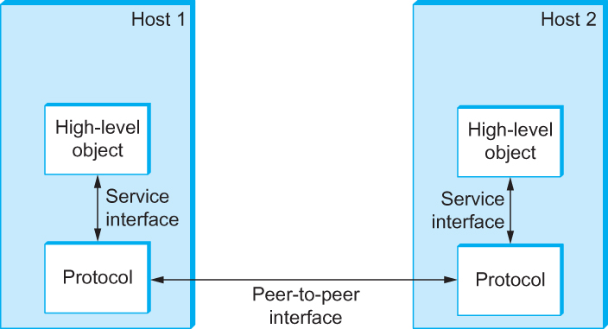
Interfaces
Service and Peer Interfaces

Slide 20
Protocols
Protocol Specification: prose, pseudo-code, state transition diagram
Interoperable: when two or more protocols that implement the specification accurately
IETF: Internet Engineering Task Force

Slide 21
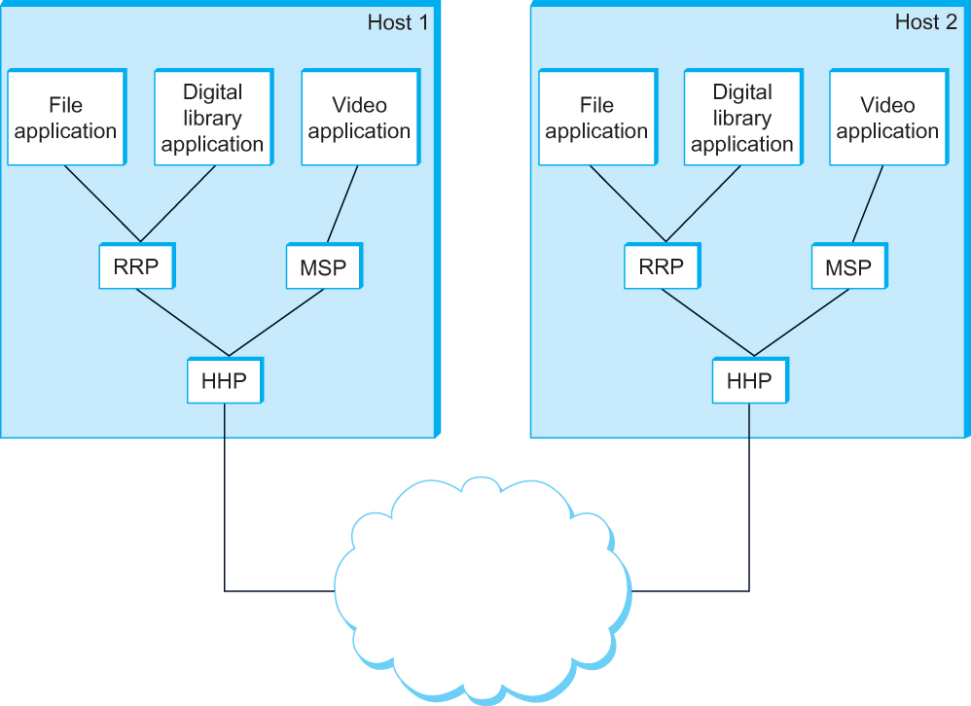
Protocol Graph
Example of a protocol graph
nodes are the protocols and links the “depends-on” relation

Slide 22
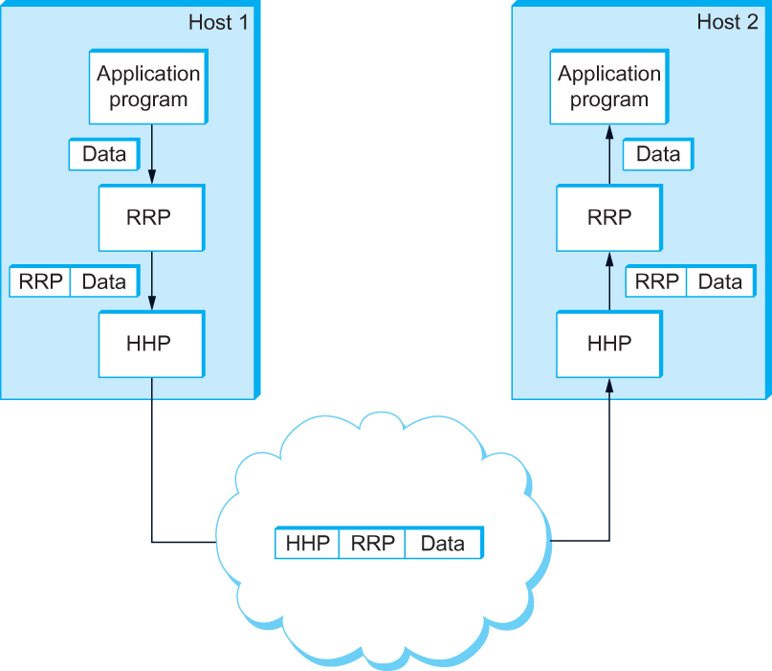
Encapsulation
High-level messages are encapsulated inside of low-level messages

Slide 23
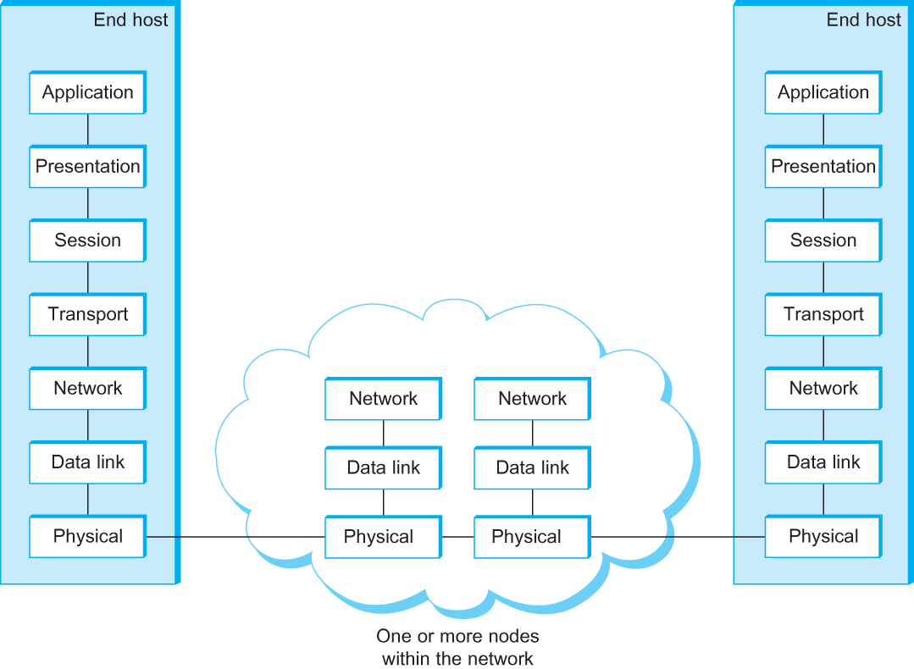
OSI Architecture
The OSI 7-layer Model
OSI – Open Systems Interconnection

Slide 24
Description of Layers
Physical Layer
Handles the transmission of raw bits over a communication link
Data Link Layer
Collects a stream of bits into a larger aggregate called a frame
Network adaptor along with device driver in OS implement the protocol in this layer
Frames are actually delivered to hosts
Network Layer
Handles routing among nodes within a packet-switched network
Unit of data exchanged between nodes in this layer is called a packet
The lower three layers are implemented on all network nodes

Slide 25
Description of Layers
Transport Layer
Implements a process-to-process channel
Unit of data exchanges in this layer is called a message
Session Layer
Provides a name space that is used to tie together the potentially different transport streams that are part of a single application
Presentation Layer
Concerned about the format of data exchanged between peers
Application Layer
Standardize common type of exchanges
The transport layer and the higher layers typically run only on end-hosts and not on the intermediate switches and routers

Slide 26
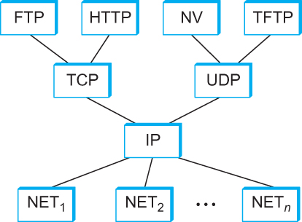
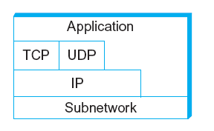
Internet Architecture
Alternative view of the Internet architecture. The “Network” layer shown here is sometimes referred to as the “sub-network” or “link” layer.
Internet Protocol Graph

Slide 27
Internet Architecture
Defined by IETF
Three main features
Does not imply strict layering. The application is free to bypass the defined transport layers and to directly use IP or other underlying networks
An hour-glass shape – wide at the top, narrow in the middle and wide at the bottom. IP serves as the focal point for the architecture
In order for a new protocol to be officially included in the architecture, there needs to be both a protocol specification and at least one (and preferably two) representative implementations of the specification

Slide 28
Application Programming Interface
Interface exported by the network
Since most network protocols are implemented (those in the high protocol stack) in software and nearly all computer systems implement their network protocols as part of the operating system, when we refer to the interface “exported by the network”, we are generally referring to the interface that the OS provides to its networking subsystem
The interface is called the network Application Programming Interface (API)

Slide 29
Application Programming Interface (Sockets)
Socket Interface was originally provided by the Berkeley distribution of Unix
- Now supported in virtually all operating systems
Each protocol provides a certain set of services, and the API provides a syntax by which those services can be invoked in this particular OS

Slide 30
Socket
What is a socket?
The point where a local application process attaches to the network
An interface between an application and the network
An application creates the socket
The interface defines operations for
Creating a socket
Attaching a socket to the network
Sending and receiving messages through the socket
Closing the socket

Slide 31
Socket
Socket Family
PF_INET denotes the Internet family
PF_UNIX denotes the Unix pipe facility
PF_PACKET denotes direct access to the network interface (i.e., it bypasses the TCP/IP protocol stack)
Socket Type
SOCK_STREAM is used to denote a byte stream
SOCK_DGRAM is an alternative that denotes a message oriented service, such as that provided by UDP

Slide 32
Creating a Socket
int sockfd = socket(address_family, type, protocol);
The socket number returned is the socket descriptor for the newly created socket
int sockfd = socket (PF_INET, SOCK_STREAM, 0);
int sockfd = socket (PF_INET, SOCK_DGRAM, 0);
The combination of PF_INET and SOCK_STREAM implies TCP

Slide 33
Client-Serve Model with TCP
Server
Passive open
Prepares to accept connection, does not actually establish a connection
Server invokes
int bind (int socket, struct sockaddr *address,
int addr_len)
int listen (int socket, int backlog)
int accept (int socket, struct sockaddr *address,
int *addr_len)

Slide 34
Client-Serve Model with TCP
Bind
Binds the newly created socket to the specified address i.e. the network address of the local participant (the server)
Address is a data structure which combines IP and port
Listen
Defines how many connections can be pending on the specified socket

Slide 35
Client-Serve Model with TCP
Accept
Carries out the passive open
Blocking operation
Does not return until a remote participant has established a connection
When it does, it returns a new socket that corresponds to the new established connection and the address argument contains the remote participant’s address

Slide 36
Client-Serve Model with TCP
Client
Application performs active open
It says who it wants to communicate with
Client invokes
int connect (int socket, struct sockaddr *address,
int addr_len)
Connect
Does not return until TCP has successfully established a connection at which application is free to begin sending data
Address contains remote machine’s address

Slide 37
Client-Serve Model with TCP
In practice
The client usually specifies only remote participant’s address and let’s the system fill in the local information
Whereas a server usually listens for messages on a well-known port
A client does not care which port it uses for itself, the OS simply selects an unused one

Slide 38
Client-Serve Model with TCP
Once a connection is established, the application process invokes two operation
int send (int socket, char *msg, int msg_len,
int flags)
int recv (int socket, char *buff, int buff_len,
int flags)

Slide 39
Example Application: Client
#include <stdio.h>
#include <sys/types.h>
#include <sys/socket.h>
#include <netinet/in.h>
#include <netdb.h>
#define SERVER_PORT 5432
#define MAX_LINE 256
int main(int argc, char * argv[])
{
FILE *fp;
struct hostent *hp;
struct sockaddr_in sin;
char *host;
char buf[MAX_LINE];
int s;
int len;
if (argc==2) {
host = argv[1];
}
else {
fprintf(stderr, "usage: simplex-talk host\n");
exit(1);
}

Slide 40
Example Application: Client
/* translate host name into peer’s IP address */
hp = gethostbyname(host);
if (!hp) {
fprintf(stderr, "simplex-talk: unknown host: %s\n", host);
exit(1);
}
/* build address data structure */
bzero((char *)&sin, sizeof(sin));
sin.sin_family = AF_INET;
bcopy(hp->h_addr, (char *)&sin.sin_addr, hp->h_length);
sin.sin_port = htons(SERVER_PORT);
/* active open */
if ((s = socket(PF_INET, SOCK_STREAM, 0)) < 0) {
perror("simplex-talk: socket");
exit(1);
}
if (connect(s, (struct sockaddr *)&sin, sizeof(sin)) < 0) {
perror("simplex-talk: connect");
close(s);
exit(1);
}
/* main loop: get and send lines of text */
while (fgets(buf, sizeof(buf), stdin)) {
buf[MAX_LINE-1] = ’\0’;
len = strlen(buf) + 1;
send(s, buf, len, 0);
}
}

Slide 41
Example Application: Server
#include <stdio.h>
#include <sys/types.h>
#include <sys/socket.h>
#include <netinet/in.h>
#include <netdb.h>
#define SERVER_PORT 5432
#define MAX_PENDING 5
#define MAX_LINE 256
int main()
{
struct sockaddr_in sin;
char buf[MAX_LINE];
int len;
int s, new_s;
/* build address data structure */
bzero((char *)&sin, sizeof(sin));
sin.sin_family = AF_INET;
sin.sin_addr.s_addr = INADDR_ANY;
sin.sin_port = htons(SERVER_PORT);
/* setup passive open */
if ((s = socket(PF_INET, SOCK_STREAM, 0)) < 0) {
perror("simplex-talk: socket");
exit(1);
}

Slide 42
Example Application: Server
if ((bind(s, (struct sockaddr *)&sin, sizeof(sin))) < 0) {
perror("simplex-talk: bind");
exit(1);
}
listen(s, MAX_PENDING);
/* wait for connection, then receive and print text */
while(1) {
if ((new_s = accept(s, (struct sockaddr *)&sin, &len)) < 0) {
perror("simplex-talk: accept");
exit(1);
}
while (len = recv(new_s, buf, sizeof(buf), 0))
fputs(buf, stdout);
close(new_s);
}
}

Slide 43
Performance
Bandwidth
Width of the frequency band
Number of bits per second that can be transmitted over a communication link
1 Mbps: 1 x 10⁶ bits/second = 1x2²⁰ bits/sec
1 x 10⁻⁶ seconds to transmit each bit or imagine that a timeline, now each bit occupies 1 micro second space.
On a 2 Mbps link the width is 0.5 micro second.
Smaller the width more will be transmission per unit time.

Slide 44
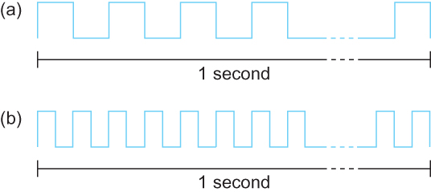
Bandwidth
Bits transmitted at a particular bandwidth can be regarded as having some width:
(a) bits transmitted at 1Mbps (each bit 1 μs wide);
(b) bits transmitted at 2Mbps (each bit 0.5 μs wide).

Slide 45
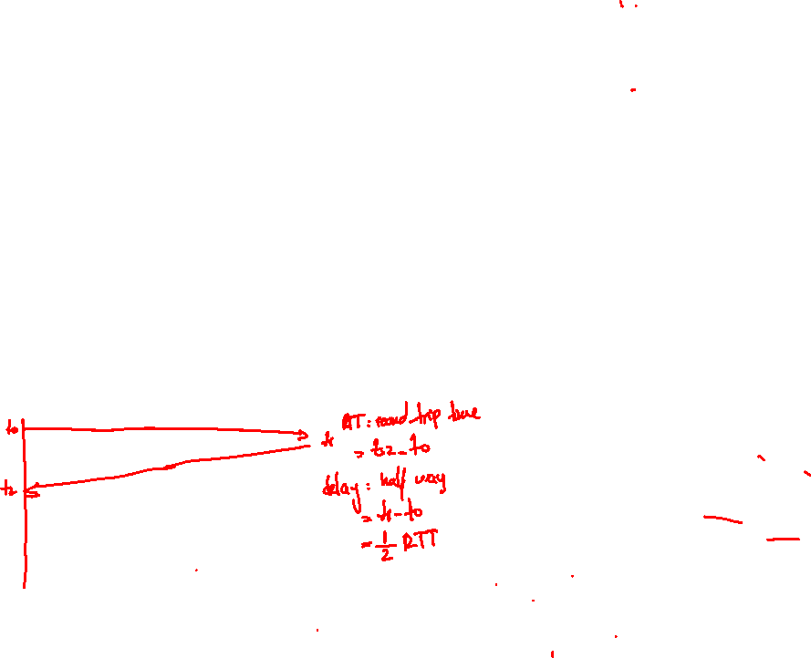
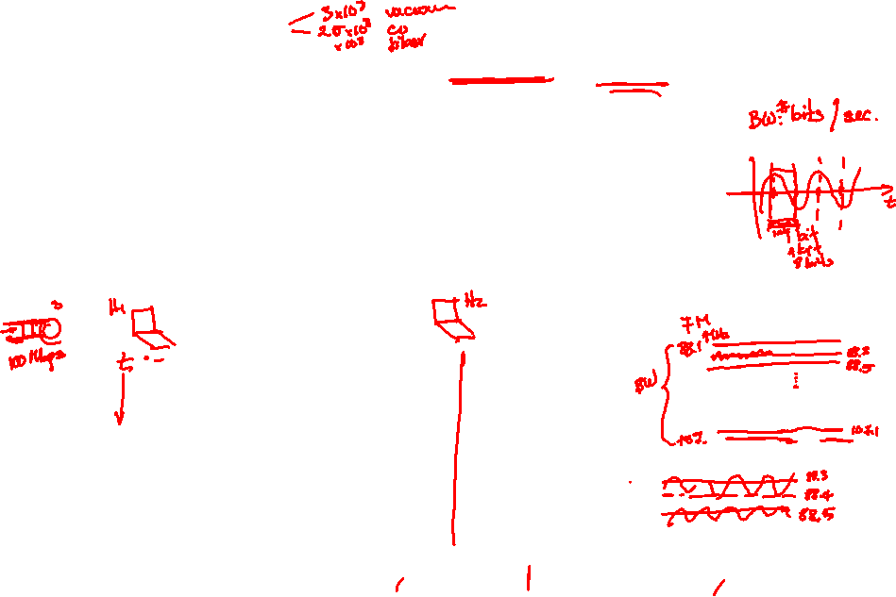
Performance
Latency = Propagation + transmit + queue
Propagation = distance/speed of light
Transmit = size/bandwidth
One bit transmission => propagation is important
Large bytes transmission => bandwidth is important

Slide 46
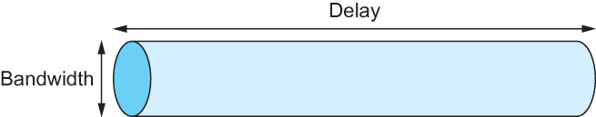
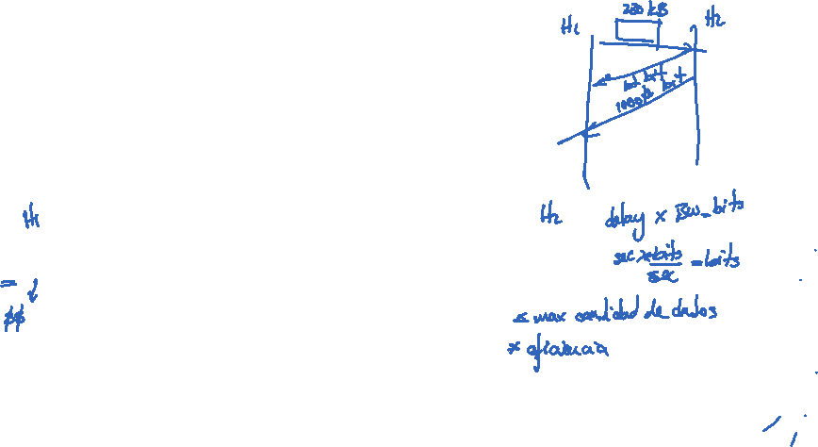
Delay X Bandwidth
We think the channel between a pair of processes as a hollow pipe
Latency (delay) length of the pipe and bandwidth the width of the pipe
Delay of 50 ms and bandwidth of 45 Mbps
50 x 10⁻³ seconds x 45 x 10⁶ bits/second
2.25 x 10⁶ bits = 280 KB data.
Network as a pipe

Slide 47
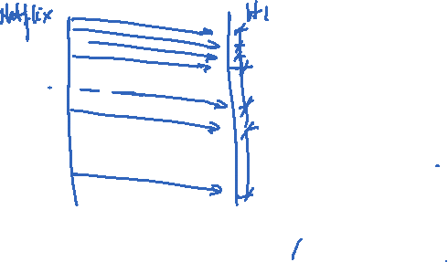
Delay X Bandwidth
Relative importance of bandwidth and latency depends on application
For large file transfer, bandwidth is critical
For small messages (HTTP, NFS, etc.), latency is critical
Variance in latency (jitter) can also affect some applications (e.g., audio/video conferencing)

Slide 48
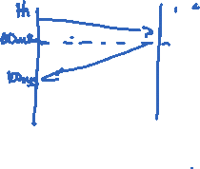
Delay X Bandwidth
How many bits the sender must transmit before the first bit arrives at the receiver if the sender keeps the pipe full
Takes another one-way latency to receive a response from the receiver
If the sender does not fill the pipe—send a whole delay × bandwidth product’s worth of data before it stops to wait for a signal—the sender will not fully utilize the network

Slide 49
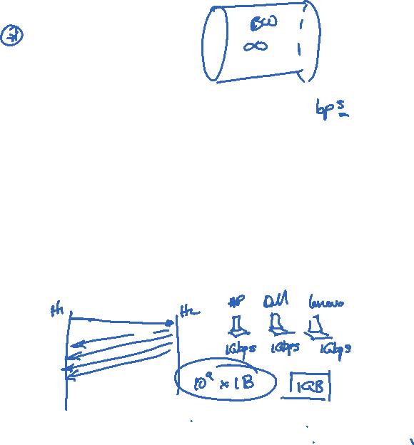
Delay X Bandwidth
Infinite bandwidth
RTT dominates
Throughput = TransferSize / TransferTime
TransferTime = RTT + 1/Bandwidth x TransferSize
Its all relative
1-MB file to 1-Gbps link looks like a 1-KB packet to 1-Mbps link

Slide 50
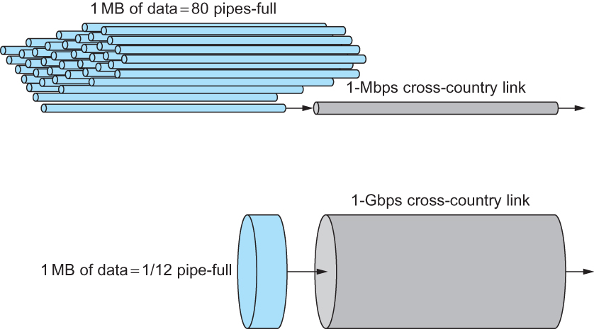
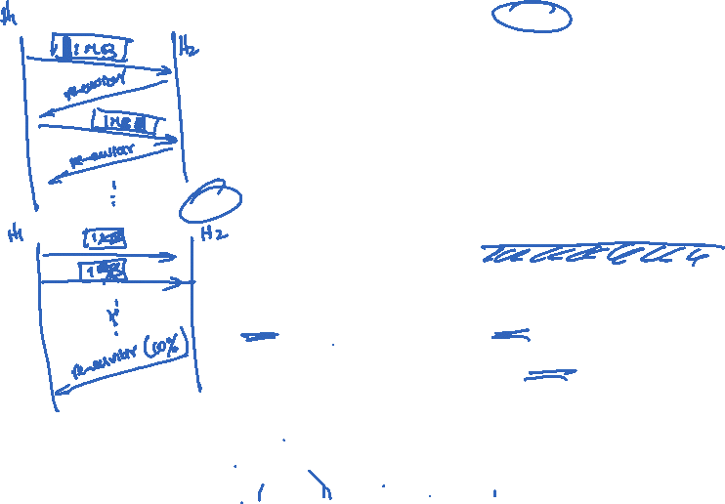
Relationship between bandwidth and latency
A 1-MB file would fill the 1-Mbps link 80 times,
but only fill the 1-Gbps link 1/12 of one time

Slide 51
Perspective
There are many stakeholders involved in building and operating networks – cloud operators, network operators, equipment vendors, open source software communities
Networking is undergoing a transformation driven by the increasing importance of clouds
Technical and non-technical factors are driving the evolution of networks
Software, disaggregated from hardware, is increasingly used to power network innovation

Slide 52
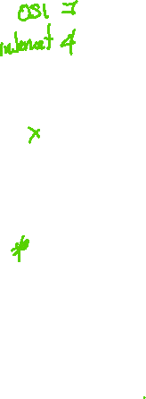
Summary
We have identified what we expect from a computer network
We have defined a layered architecture for computer network that will serve as a blueprint for our design
We have discussed the socket interface which will be used by applications for invoking the services of the network subsystem
We have discussed two performance metrics using which we can analyze the performance of computer networks

